Slide 1


Avocado Machine Learning Project
SANTHOSH KUMAR B V S R K
https://github.com/santhoshbvsrk/Machine-Learning-Projects/tree/main/Avocado-Machine-Learning-Project

Slide 2

Problem Statement
The goal is to build a model to predict the Average price of Avocados which is continuous in nature of different types of Avocados.

Slide 3

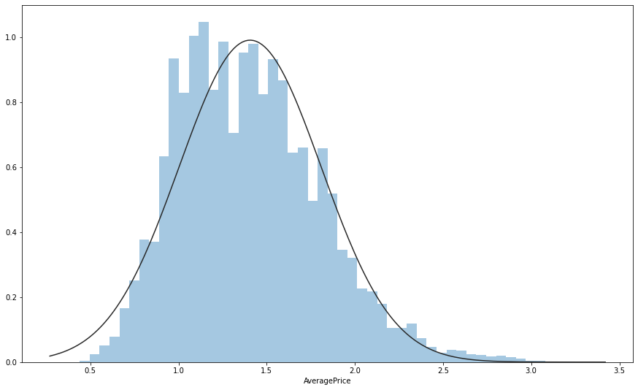
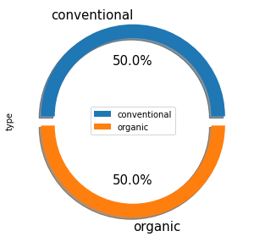

Exploratory data analysis
Average Price Distribution
2 types of Avocado. Conventional & Organic

Slide 4
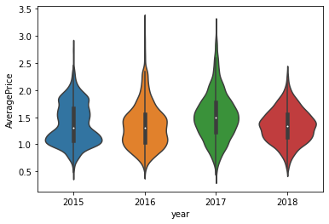
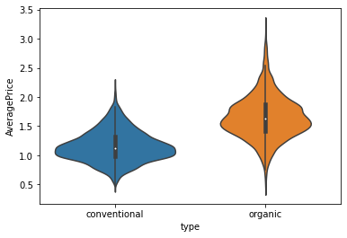


Average Price is highest in 2016 & Least in 2017.
Average Price varied a lot in 2016 & 2017.
Average Price of Organic Avocado's is higher than Conventional.
Average Price Vs Year
Average Price Vs Type
Average Price analysis

Slide 5
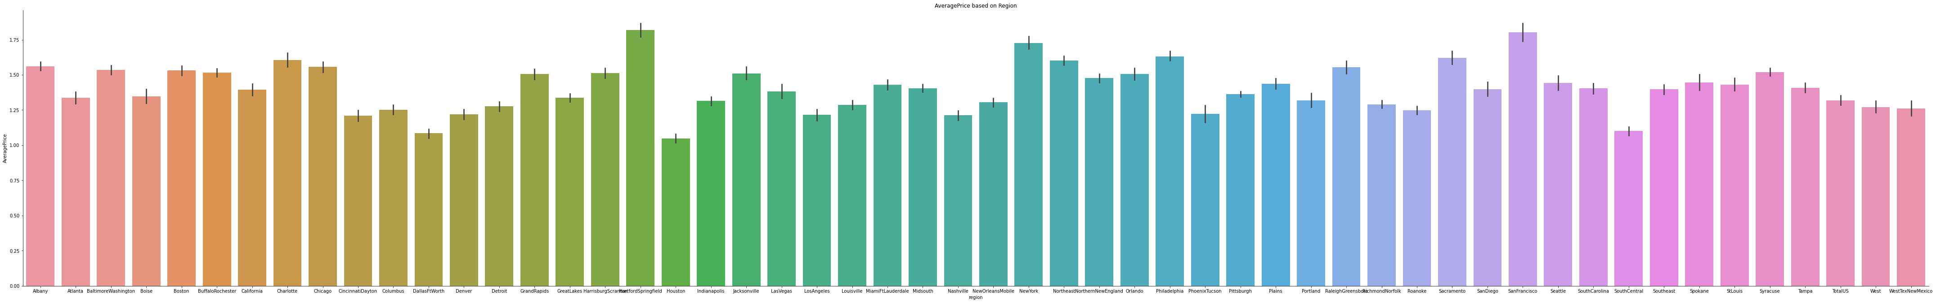
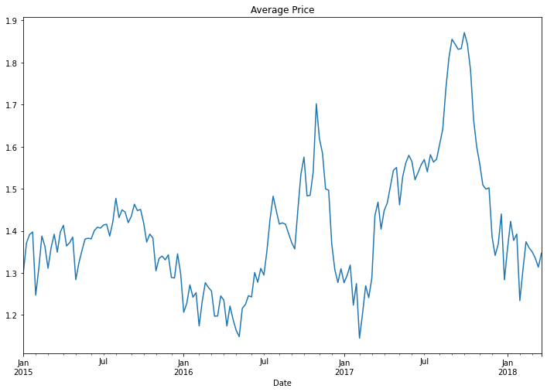
Average Price Vs Region
Average Price is highest in Sanfrancisco & least in CincinnatiDayton
Average Price is highest in October 2017 & Least in August 2017.
Average Price Vs Date
Average Price analysis

Slide 6
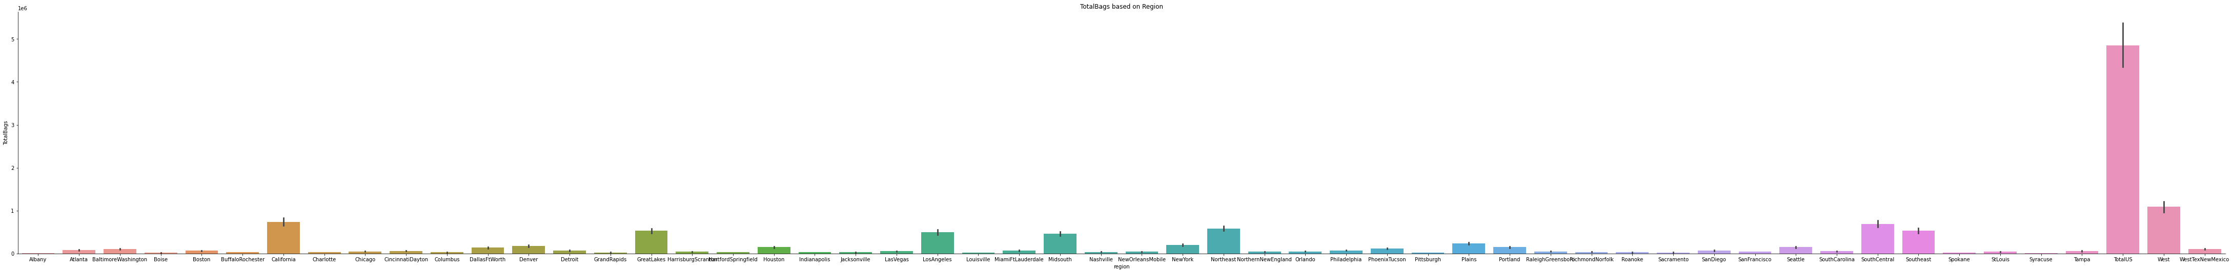
Total Bags Sold Vs Region
Total Bags of Avocados consumed is highest in Total US.
Bags analysis

Slide 7
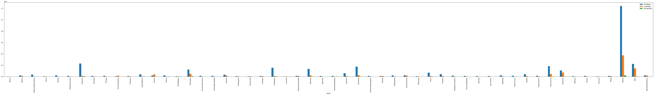
Type of Bags Sold Vs Region
Small, Large & XLarge Bags are highest sold in TotalUS region.
Small Bags are the highest sold, followed by Large & XLarge.
XLarge Bags aren’t purchased in most of the regions.
Large Bags are purchased in all regions except Albany.
The Least purchasing region is Albany.
Bags analysis

Slide 8
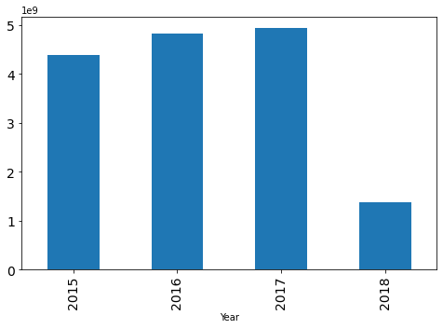
Total Volume Vs Region
Total Volume i.e., Avocado's are highly consumed in Total US, followed by West, California, South Central & South East.
Total Volume Vs Year
Consumption volume increased from 2015 to 2017 first half and then declined sharply in 2018.
Total volume vs region

Slide 9
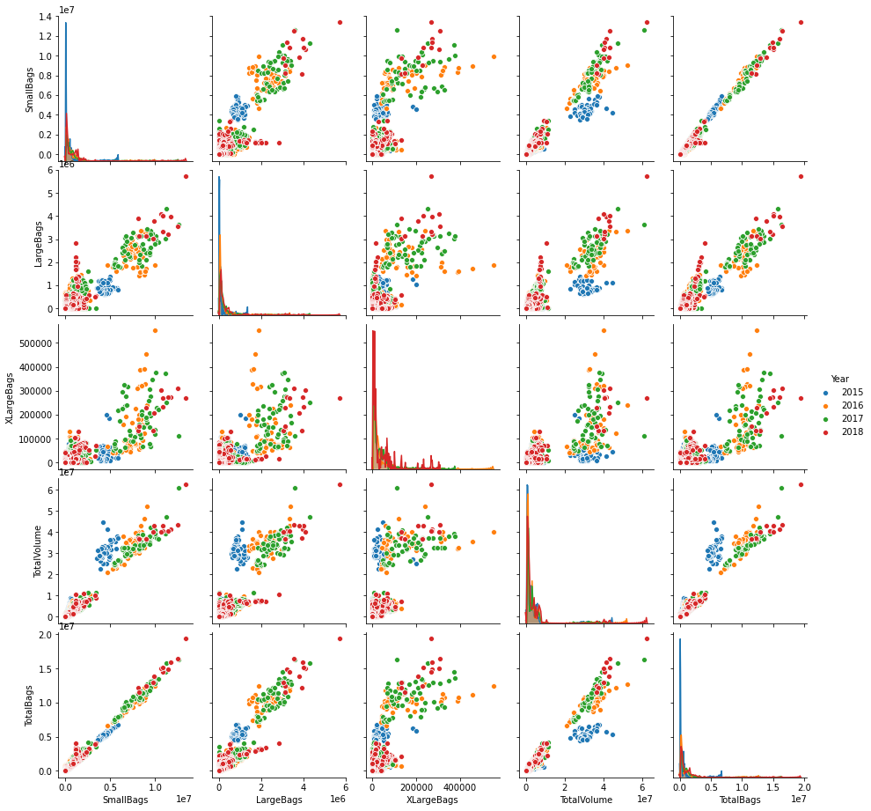

Bags Vs Volume vs year
Ratio of Small Bags to Total Bags i.e., out of all the Bags sold, Small Bags ratio is highest in 2018 followed by 2015.
Total Bags sold is highest in 2015 and least in 2018.

Slide 10
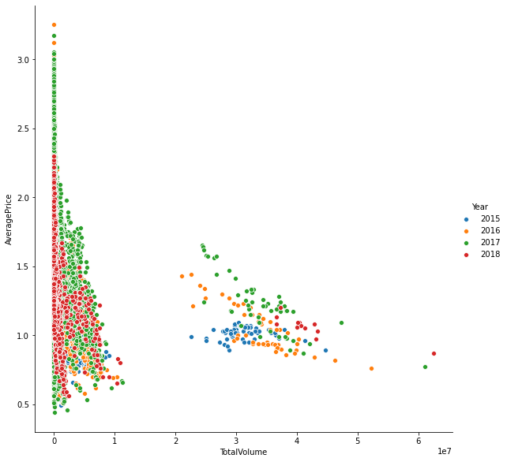
Average Price Vs Volume vs year
Average Price is highest in 2016 followed by 2017.
Total Volume is highest in 2018 followed by 2017.

Slide 11
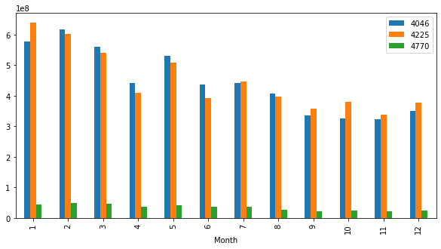
PLU Analysis
PLU Vs Month
Avocados with PLU Code 4770's consumption is slightly declined towards the end of the year.
Avocados with PLU Code 4225's & 4046's consumption has declined towards the end of the year.
Avocados with PLU Code 4770's are least consumed throughout the year whereas 4225 & 4046 are almost equally consumed.
Avocados with PLU Code 4225 are more consumed in February and least consumed in October & November.
Avocados with PLU Code 4225 are more consumed in January and least in November.
Avocados with PLU Code 4770 consumption is almost constant till July and then declined constantly towards end of the Year.

Slide 12
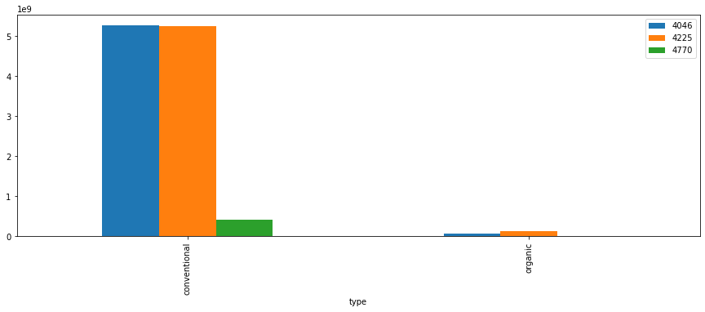
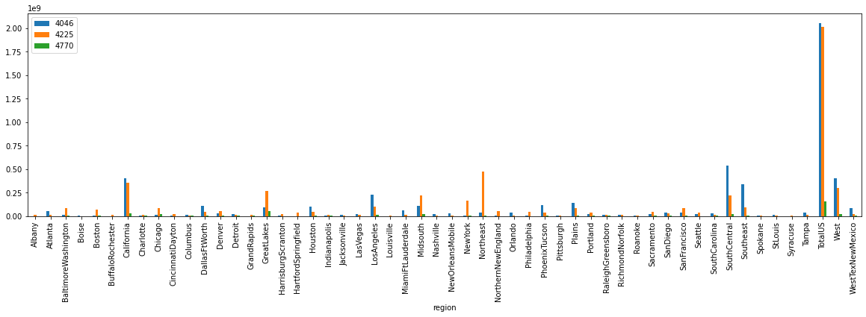
PLU Analysis
PLU Vs Type
PLU Vs Type
Conventional Avocados are highly sold of which 4046 are highly sold followed by 4225.
Organic Avocados with LPU code 4770 are not sold at all.
PLU Vs Region
PLU Vs Region
Avocados with PLU Code 4046 are the highest Sold across regions.
Total US has highest consumption of Avocados of which PLU Code 4046 are max consumed, followed by 4225 & 4770.
Avocados of all 3 PLU Codes consumption is highest in Total US followed by South Central, California, West & Los Angeles.

Slide 13
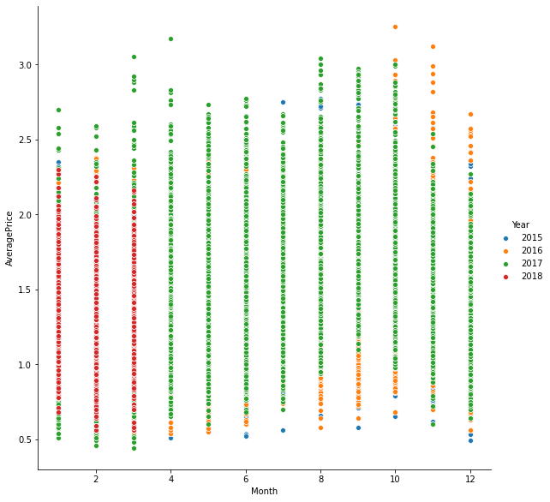
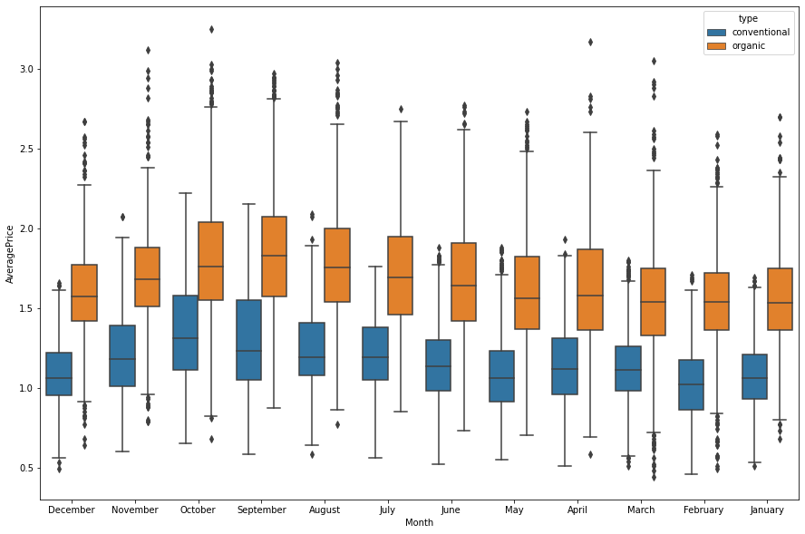
AveragePrice Vs Month Vs Year
AveragePrice Vs Month Vs Year
Average Price is highest in the Month of October 2016 and is least in March 2017.
AveragePrice Vs Month Vs Type
AveragePrice Vs Month Vs Type
Organic Avocados AveragePrice is high when compared to Conventional.
Organic Avocados AveragePrice is highest in October and Least in March.
Organic Avocados AveragePrice range is highest in April.
Conventional Avocados AveragePrice is highest in August and Least in December.
Conventional Avocados AveragePrice range is highest in September.

Slide 14
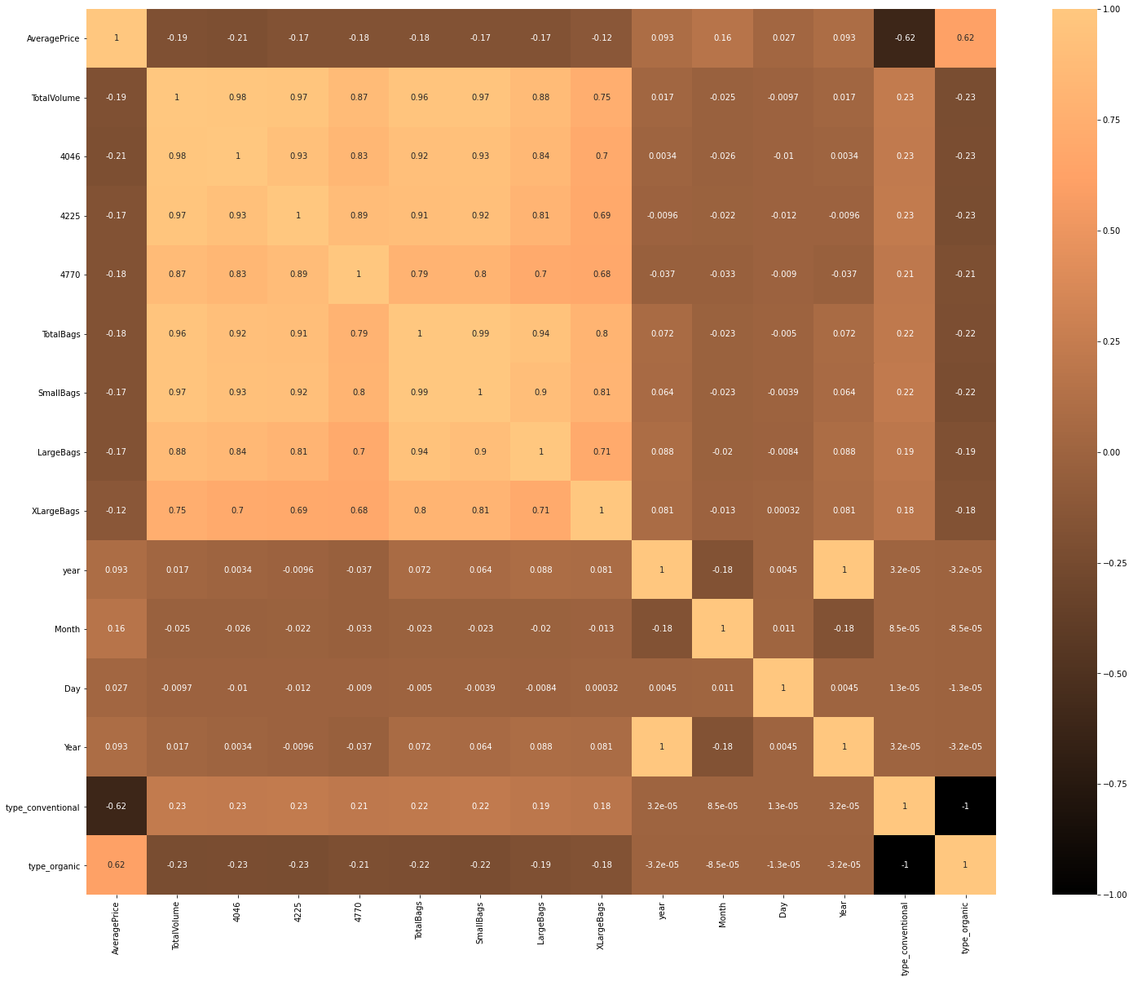
Correlation Matrix
Total Bags sold is highly correlated with Small Bags sold.
Avocados 4046 are highly correlated with Total Volume.
Avocados 4225 are highly correlated with Total Volume.
Conventional Avocados are least correlated with AveragePrice.

Slide 15
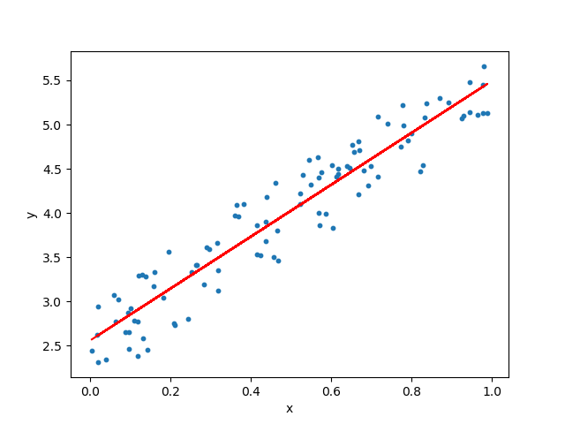
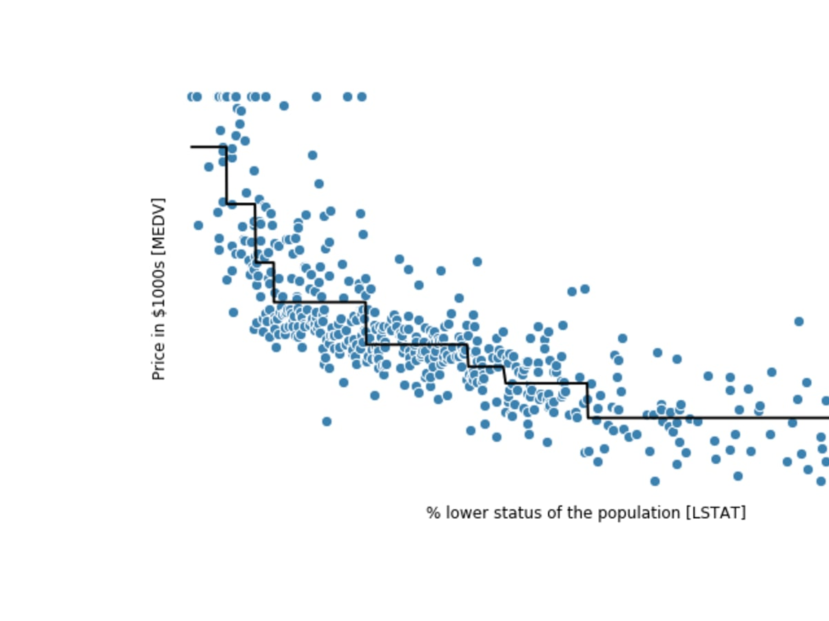
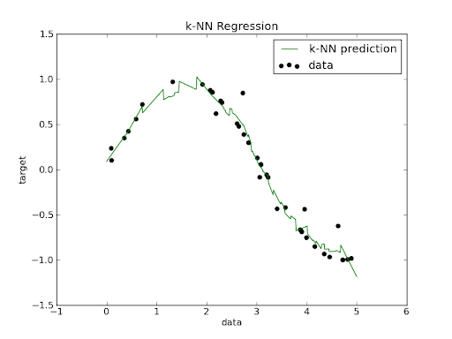
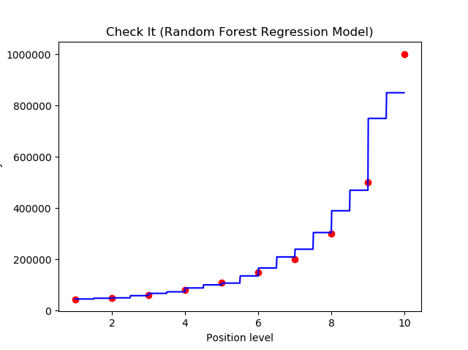
ml modelling techniques
Regression Models used:
Linear Regression
Decision Tree Regressor
Random Forest Regressor
KNN Regressor
Linear Regression
Decision Tree Regressor
Random Forest Regressor
KNN Regressor

Slide 16
ML Model Building
Dividing data set into Source Features & Target Feature.
Splitting data into Train & Test data with a split ratio of 80:20.
Running Regression Models on the Train Data i.e., fitting model on Training data & Predicting Target Feature values on the model.
Model Evaluation – This is where we evaluate the model by finding the Error or Residual of the predicted values with that to actual. So, that we can choose a model with a less error/residual.

Slide 17
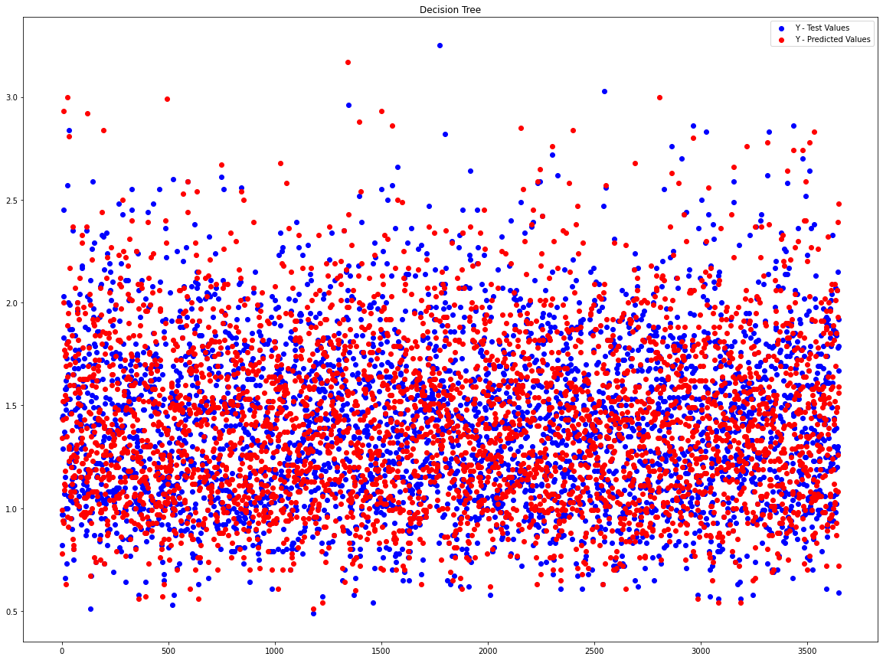
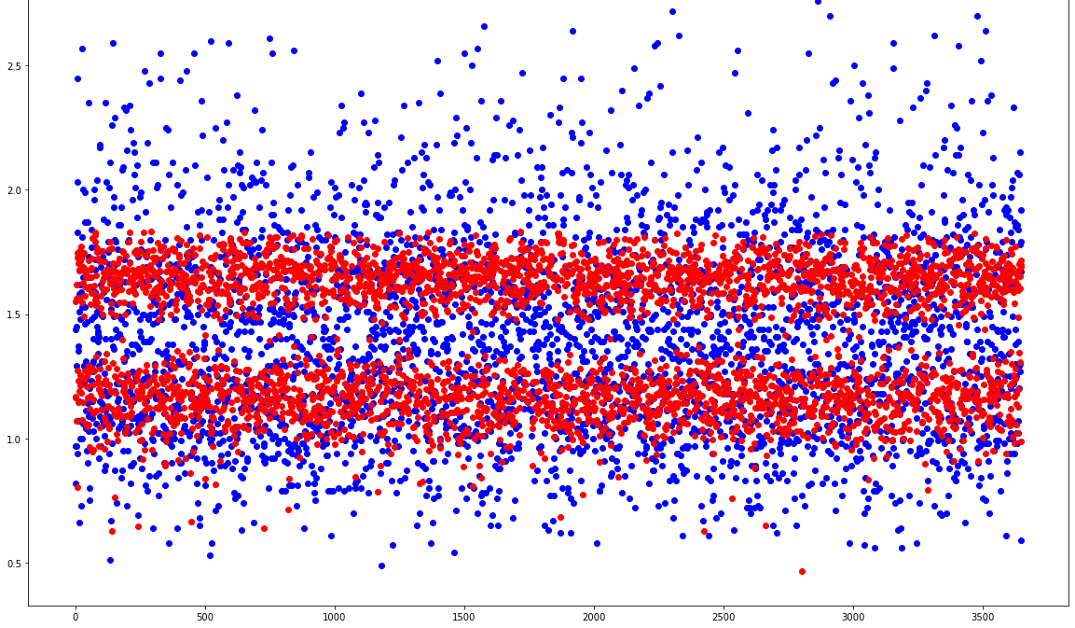
Plots between Test & Predicted Values (Linear Regression & Decision Tree)
Linear Regression
Decision Tree

Slide 18
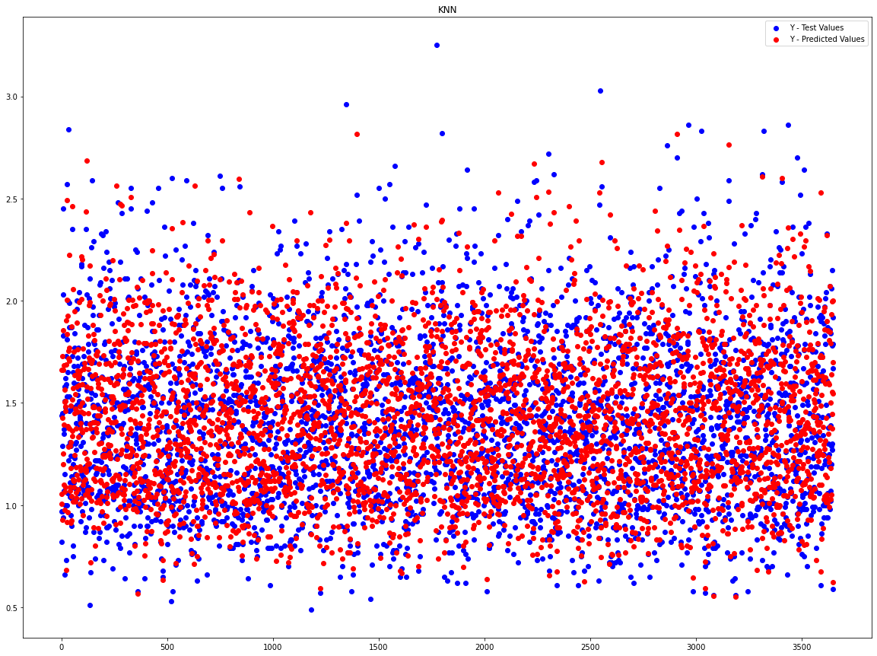
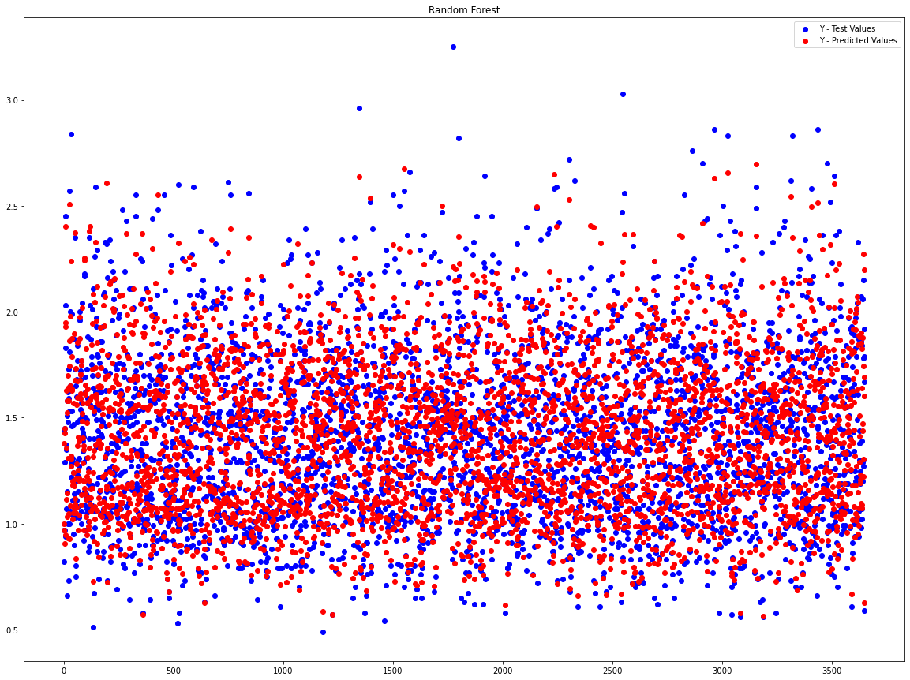
Plots between Test & Predicted Values (Random Forest & KNN)
Random Forest
KNN

Slide 19
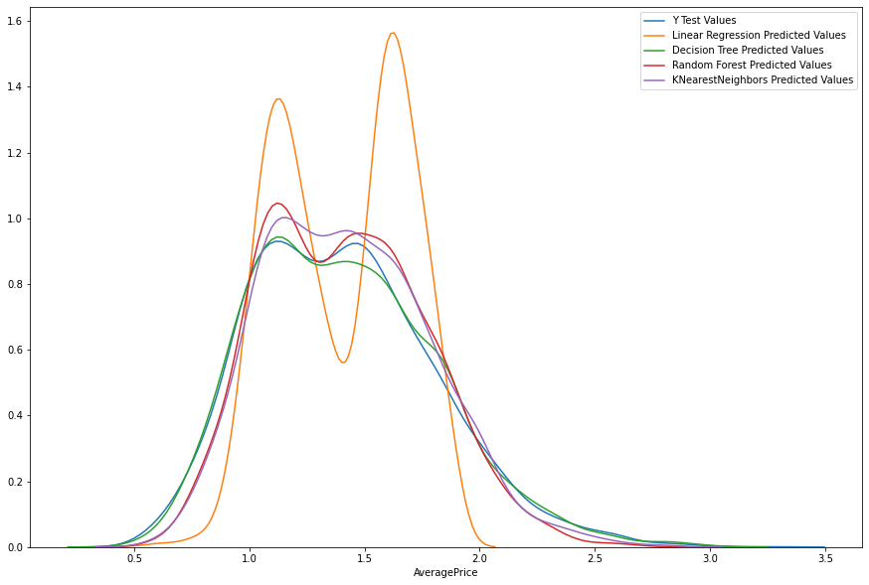
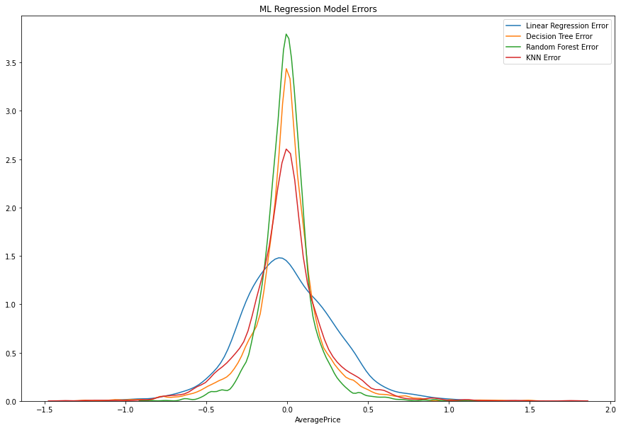
Predicted Values & Residual plots for the ml models used
Predicted & Test Values Plot
Residual/Error Plot

Slide 20
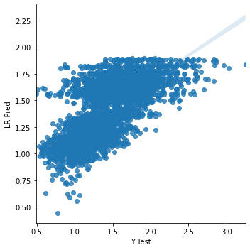
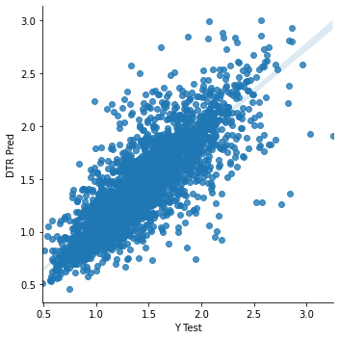
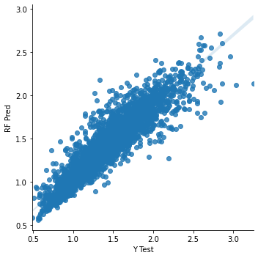
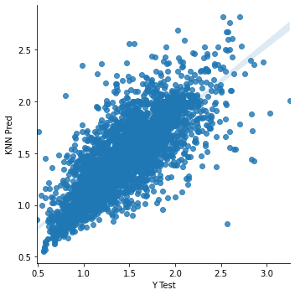
Models Predicted Values plots
Linear Regression
Decision Tree
Random Forest
KNN

Slide 21
Model Evaluation Metrics
The Model Evaluation Metrics Used are:
Mean Absolute Error
Mean Square Error
Root Mean Square Error
R Square Error
Mean Absolute Percentage Error

Slide 22
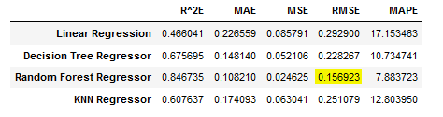
Model Evaluation Metrics

Slide 23
Conclusion
Average Price is normally distributed.
Small / medium sized avocados in small sized bags are preferred
Small sized bags are more preferred
Annual variation in price peaking in Sept – Oct
Conventionally farmed option preferred, probably because of the price.
For this Problem, we'll be considering RMSE as our Evaluation Metric and from which it is evident that Random Forest has least Error score.
Even in Mean Absolute Error, Mean Square Error Evaluation Metrics, Random Forest has the least Error Score.
Hence, we'll be considering Random Forest as our Model for predicting values for this problem.

Slide 24
Thank you
https://github.com/santhoshbvsrk/Machine-Learning-Projects/tree/main/Avocado-Machine-Learning-Project

